Slide 1
Case-Based Reasoning (CBR)
Litty Tressa George
FICT

Slide 2
Introduction
Case-Based Reasoning (CBR) is an Artificial Intelligence approach to learning and problem solving based on past experience.
CBR combines aspects from the knowledge-based systems as well as from the machine learning field
A past experience is stored in the form of solved problems (“cases”) in a so-called case base.
A new problem is solved based on adapting solutions of known similar problems to this new problem..

Slide 3
Case-Based Reasoning (CBR) uses precedents (prior decisions or actions) to inform the current decisions
CBR is
intuitive
relatively simple to implement
transparent
and it learns

Slide 4
Case-Based Reasoning Terminologies
Case := Problem (characterization)/Solution (artifact) Pair
Query: Query at hand defines (ie; problem statement) new case (problem without solution)
Retrieve: New case is used to find most similar case from the known (previous) cases
Reuse: New and retrieved case are combined to a proposed case including the suggested artifact.
Revise: Suggested artifact is applied and evaluated
Retain: Useful experiences from applying the artifact are retained by adapting the case base and the conceptual knowledge.
Note: Technically, artifacts are solutions or intermediate solutions produced in the process of development of a solution which had already implemented in the previous history.

Slide 5
Case-Based Reasoning Process
In the retrieve task new case is used to find a matching case from the collection of previous cases.
The retrieved case is combined with the input case - in the reuse task - into a proposed solution to the initial problem.
The revise task tests this solution for success, for example, by applying it to the real-life environment or having it evaluated by a supervisor, and repaired if failed.
This task is important for learning, since the system needs feedback on how successful its proposed solution actually was.
Retain is the main learning task, where useful experience is retained for future reuse, by updating the case base and possibly also the general domain knowledge.

Slide 6
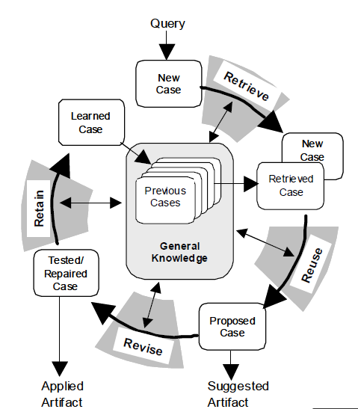
Case-Based Reasoning Process Model

Slide 7
For solving a new problem. a query is submitted to a CBR system to retrieve the solutions of the most similar problems/cases in the case base.
The query is considered as a potential new case.
The underlying idea of CBR is simple: It do not solve problems from scratch but remember how you (or someone else) solved a similar problem and apply this knowledge to solve your current problem.

Slide 8
CBR is an approach for developing knowledge-based systems
CBR is an approach for learning from experience (examples, cases)
CBR is a knowledge based extension of the nearest neighbor classifier paradigm known from pattern recognition.
CBR is a Knowledge based information retrieval.

Slide 9
A case-based reasoning system uses a memory that can store solutions to past problems, along with information about whether each solution was successful or not.
Such a system must therefore have the ability to look up a new problem, in order to find a previous case that was similar or identical to the current problem.
Once such a case is found, the solution that was applied earlier is modified in order to apply it directly to the current problem.
This solution is then stored in the memory, along with information about whether it succeeded or failed.

Slide 10
For a case-based system to function adequately, the representation of cases must be carefully considered.
The details that are used to index each case need to be relevant and also must be able to distinguish the case from other, dissimilar cases.
Case-based systems make the task of knowledge acquisition relatively straightforward: the knowledge engineer simply needs to obtain examples of problems and their solutions (cases), which are entered into the system’s memory.

Slide 11
As the system encounters more cases, it becomes better able to solve new problems.
Of course, as the database of cases becomes larger, it becomes slower at retrieving cases from the database, and so there is a trade-off between performance and efficiency.
It is possible to avoid this problem by only storing the most successful solutions and “forgetting” solutions that were less successful.

